Slide 2
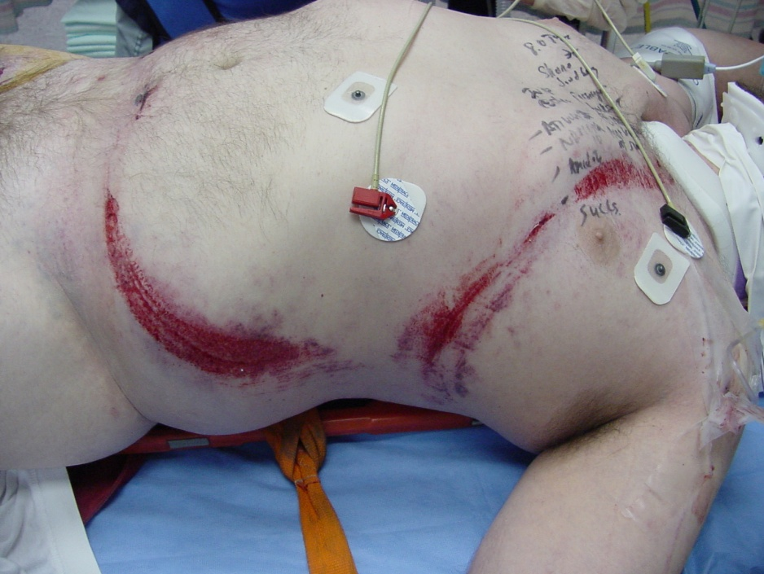
Trauma van het Abdomen
Notes:
5-1 Title Slide
Introduce the topic and explain to the students that, based on their preparation for the course, student participation and responses are expected.
Photograph of seatbelt injury courtesy of John Fildes, MD, FACS

Slide 3
Trauma Abdomen
Wat zijn de anatomische grenzen van de buik ?
Notes:
5-5 Abdominal Injury: When should you suspect abdominal injury?
Elicit responses from the students.
Answers appear on next slide.

Slide 4
Trauma Abdomen
Wat voor onderscheid in buikletsel kan je maken ?
Notes:
4
5-6 Abdominal Injury: When should you suspect abdominal injury?
The history and physical exam findings suggesting abdominal injury in blunt and penetrating trauma are listed.

Slide 5
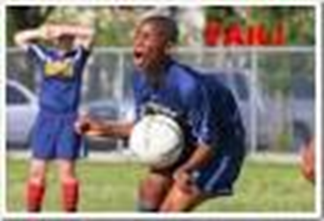
Traumamechanisme
Zeldzaam ?
Hoe bekijk je deze patiënten ?
Notes:
5-2 Case Scenario
The discussion of this case should emphasize the need to evaluate the abdomen first for hemorrhage quickly, and to discover other injuries that may lead to delayed mortality and morbidity.
The patient is 35 years old and was involved in a high speed motor vehicle crash. Vital signs are: BP 105/80; P 110; RR 18; and GCS 15. He complains of pain in his chest, abdomen and pelvis.
The discussion should dispense quickly with ABCs and move on to the abdominal evaluation.
Elicit from the students the fact that, from the mechanism of injury, history, and inspection, there is likely an abdominal injury. Ask how they would begin to evaluate it.

Slide 6
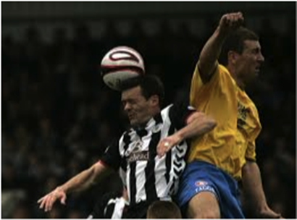
Trauma Abdomen
Lichamelijk onderzoek
ABCDE
Look, Listen, Feel
Notes:
5-10 Abdominal Injury: How do I determine if there is an abdominal injury?
Reveal the bulleted items after eliciting responses from the student.
Physical exam should include inspection, auscultation, percussion, and palpation.
After identifying “auscultation,” ask the students where to auscultate and what to listen for. The answer: all four quadrants for the presence or absence of bowel sounds.
Explain that free intraperitoneal blood or gastrointestinal contents can produce an ileus.
Caution the students that injuries to adjacent structures also can produce an ileus when an intraabdominal injury does not exist.
After identifying “percussion,” ask the students about subtle signs of peritonitis, tympanitic sounds, and diffuse dullness. Obvious pain and involuntary guarding are indicative of rebound, and further maneuvers to elicit it (“Does it hurt worse when I push in or let off?”) are not necessary and only cause the patient undue discomfort.
After the students identify “palpation,” ask them about the significance of involuntary muscle guarding, rebound tenderness, and the presence of a pregnant uterus.

Slide 7
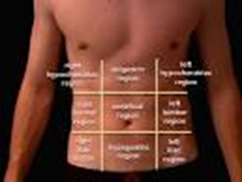
LOOK
Haematomen
Schoen afdruk
Excoriaties
Pijn
LISTEN
Peristaltiek (?)
FEEL
Pols
RR
Drukpijn / aanspanning

Slide 8
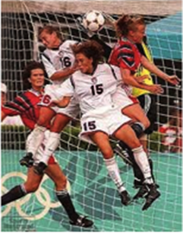
Trauma Abdomen
Stomp Mechanisme
Meest aangedane organen
Milt
Lever
Dunne darm
Nier
Alle organen
Notes:
5-7 Abdominal Injury: Blunt Force Mechanism
What organs are most commonly injured in blunt trauma?
The most commonly injured intraabdominal organs in blunt trauma are: (1) spleen (40% to 55%), (2) liver (35% to 45%), and bowel (5% to 10%).
As the students list the organs, ask them about the types of blunt force that cause the injuries: (1) compression: direct blow to liver or blowout of the bowel; (2) crushing: direct blow to the epigastrium with crushing of the pancreas over the spine; and (3) shearing: inappropriate location of the lap belt contributing to bowel injury.
Airbag deployment does not preclude injury.
Three-point restraints are better than the use of the lap belt only, and the lap belt is better than no restraint.
Explain that solid organs bleed, but the patient may be nonoperatively managed (observed) if the bleeding is slow and spontaneously stops.

Slide 9
Trauma Abdomen
Factoren die het onderzoek beïnvloeden
Alcohol en drugs
Andere ‘’destracting’’ letsel
Aanvankelijk weinig symptomen !
Notes:
5-11 Abdominal Injury: Factors that compromise the exam
During the discussion on assessment, ask the students what factors can compromise the abdominal examination. The students should respond with the bulleted items on the slide.
You may ask the students, “How do associated orthopedic injuries compromise, limit, or distract from the abdominal examination?”

