Slide 1
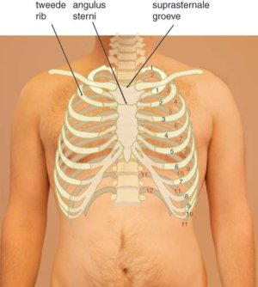
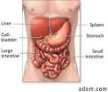


Thorax en abdomen
16 – 04 – 2014
Tessa Biesheuvel
AFAS stadion
Congres traumatologie

Slide 2
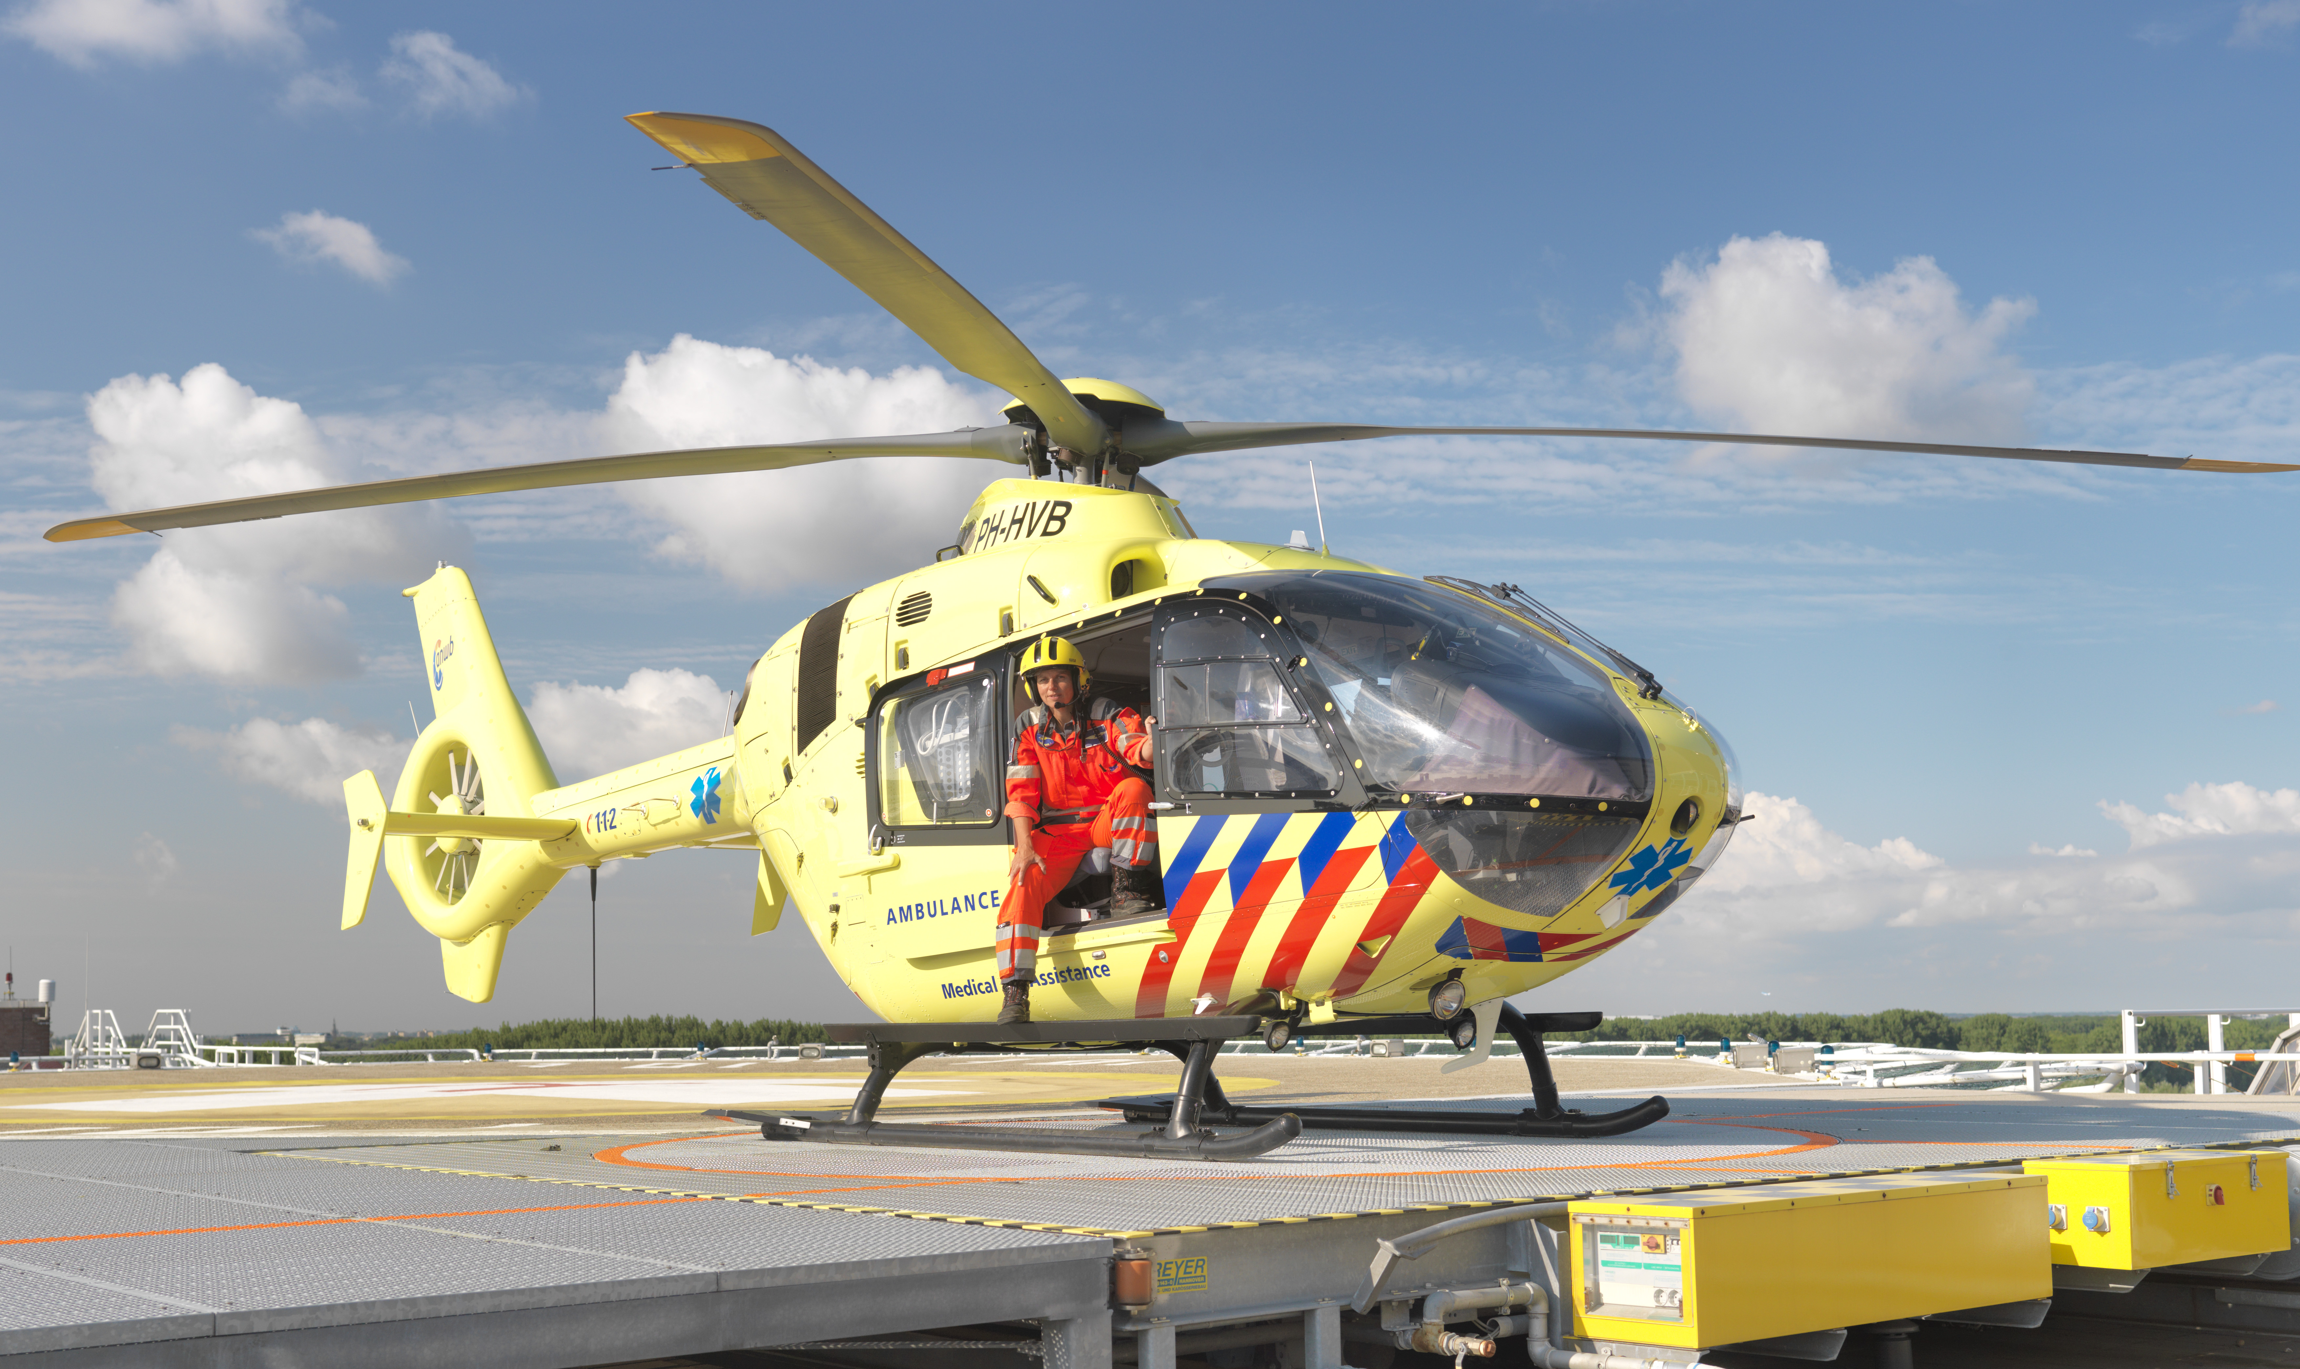



Slide 3
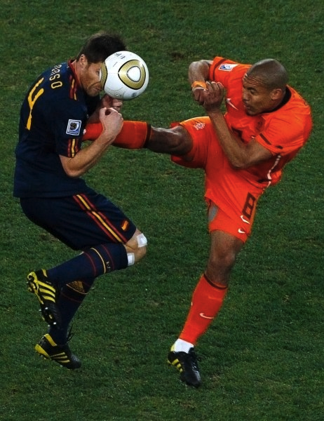
Thoraxletsel ?

Slide 4
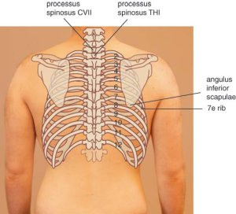

Slide 5
Thorax Trauma
  Significante oorzaak mortaliteit
  < 10% operatief ingrijpen
  Verschil in scherp en stomp letsel
  Bij scherp letsel 15-30% operatie
  Meeste patiënten simpele procedures
Notes:
4-5 Thoracic Trauma
Review this information with the students.
Emphasize that chest injuries remain a significant cause of morbidity and mortality among trauma patients.
Life-threatening injuries associated with thoracic injuries are identified in the primary survey by carefully assessing the patient’s ABCs.
Identified injuries usually require simple interventions to secure the airway, reexpand the lung, drain the pleural space, and improve breathing mechanics.
Most penetrating wounds to the chest require a thoracostomy tube.
A minority of patients with chest injuries require urgent surgical exploration due to bleeding.
Use the final point to elicit the six life threatening injuries on the subsequent slide.

Slide 7
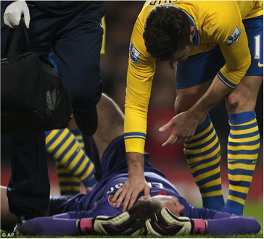
Waar op te letten ?
Look
Listen
Feel

Slide 8
Waar op te letten ?
ABCD
LOOK:
  Hematomen / wonden ?
  Thoraxwand deformatie ?
  Ademhalingsfrequentie
  Hulpademhalingsspieren / “respiratoire nood” ?
  Neusvleugelen
  Trachea mediaan
  Nekvenen
  Sputum

Slide 9
Vervolg, waar op letten ?
LISTEN:
  Stridor
  Andere percussie
  Verminderd ademgeruis
FEEL:
  Symmetrische ademexcusies
  Subcutaan emfyseem
  Crepitaties
  Pijn

Slide 10

The big 5
5 levensbedreigende thoraxletsel

Slide 11
The big 5
A
B Spanningspneumothorax
Open pneumothorax
Fladder thorax en Long contusie
C Massieve hematothorax
Cardiale tamponade

Slide 12
Spanningspneumothorax
  Onrust
  Shock
  Uitgezette nekvenen
  ↓ AG
  Hypersonoor
  Cyanose (laat !)
Notes:
4-9 Tension Pneumothorax
How do I identify a tension pneumothorax? How do I differentiate a tension pneumothorax from cardiac tamponade and hemorrhagic shock?
During the discussion of differentiating a tension pneumothorax from cardiac tamponade and hemorrhagic shock, relate that blunt injury is a more likely cause of tension pneumothorax.
Cardiac tamponade occurs more often with penetrating trauma.
If hypovolemia exists, the patient’s neck veins will not be distended.

Slide 13
Fladderthorax en Longcontusie
  Zuurstof
  Reëxpanderen long
  Intuberen
  Matig infuus
  Pijnstilling
Notes:
4-14 Flail Chest and Pulmonary Contusion
How do I treat the patient with a flail chest and/or pulmonary contusion?
Emphasize that the treatment goal is to reexpand the lung, eg, with CPAP (positive pressure) or physiotherapy, and to avoid progressive atelectasis.
Analgesia is an important adjunct, but oversedation will promote hypoventilation and atelectasis.

Slide 14
Massieve Hematothorax
  Systemische - / long vaten
  > 1500 mL bloed- verlies
  Platte nekvenen
  Shock zonder AG en met gedempte percussie
Notes:
4-15 Massive Hemothorax
What is the cause and how do I identify if the patient has a massive hemothorax?
Note that this type of injury results in a ‘B’ and ‘C’ problem.
X-ray courtesy of Ray McGlone, Royal Lancaster Infirmary; UK

Slide 15
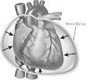
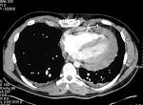
Hart Tamponade
  ↓ pols
  Uitgezette nekvenen
  Zachte harttonen
  PEA
Notes:
4-17 Cardiac Tamponade
This photograph shows a patient with a parasternal penetrating injury, self-inflicted with a car radio antenna. (Note: The patient’s head is at the bottom of the photograph where one can see the oxygen mask.)
Ensure that the students understand that blunt trauma to the chest can cause cardiac tamponade, but that most survivors of cardiac tamponade have an anterior or posterior penetrating wound to the chest.
During the discussion about signs and symptoms of the patient with cardiac tamponade, emphasize the fact that not all findings must be present.
Explain that cardiac tamponade is suspected if the patient has a penetrating parasternal wound. Clinical signs may include hypotension and dyspnea, or the patient verbalizing that he or she senses he or she is dying.
Photograph used with permission of Trauma.org; Frederick Foss; chest0016a; http://www.trauma.org/imagebank/imagebank.html

Slide 16
Andere potentieel bedreigende letsels
Letsel aan de bronchiaal boom
Simpele pneumothorax
Longcontusie
Hematothorax
Corcontusie
Aortaruptuur
Oesophagusletsel
Traumatisch diafragma letsel

Slide 17
Andere potentieel bedreigende letsels

Slide 18
Simpele Pneumothorax
  Stomp / Scherp
  Hypersonore percussie
  ↓ AG
  Thoraxdrain
Notes:
4-26 Simple Pneumothorax
How do I identify and treat a simple pneumothorax?
The students should understand that a pneumothorax can occur after blunt and penetrating injury to the chest, although it may not be apparent on physical examination.
After describing how to identify and treat this injury, ask about the usefulness of obtaining a chest x-ray, which can help identify this injury.
Remind students of the need to assess for subcutaneous emphysema.
The presence of decreased breath sounds is not always a helpful indicator for a pneumothorax, especially if the patient is hyperventilating from pain or is in shock.
The students should know that this injury is treated with tube thoracostomy.

Slide 19
Fracturen rondom thorax en geassocieerd letsel
Sternum, Scapula, Rib
  Rib 1-3
  Hoog energetisch
  Mortaliteit door onderliggend letsel
  Rib 4-9
  Longcontusie en pneumothorax
  Rib 10-12
  Denk aan buikletsel
KINDEREN VRIJWEL NOOIT RIBFRACTUREN
Notes:
4-37 Fractures and Associated Injuries
What associated injuries should I suspect and assess for when my patient has fractures of the chest wall?
Explain that the location of the fracture provides clues about other possible injuries.
The students should understand that it requires a significant force to fracture ribs 1-3.
Patients with these fractures commonly have many associated injuries and are at a higher risk for mortality.
Fractures of ribs 4-9 are commonly associated with flail chest, pulmonary contusion, and pneumothorax.
Lower rib fractures are associated with intraabdominal injury.
Time permitting, review diaphragmatic excursion and its relationship to intraabdominal injuries and lower thoracic injuries.

Slide 20
Longcontusie
  VAAK !
  Pijn, dyspneu, hemoptoë, hypoxie
  Oxygeneren
  Eventueel beademen
  Late verandering op X thorax
Notes:
4-27 Pulmonary Contusion
How do I identify and treat a pulmonary contusion?
A pulmonary contusion can be mild to severe and may cause very little hypoxia to severe hypoxia.
The diagnosis can be confirmed by a chest x-ray or a CT scan of the chest.
Most pulmonary contusions increase in size and severity after fluid resuscitation.
The students should know that treatment includes normovolemia and maneuvers to maintain lung volumes.
X-ray courtesy of Ray McGlone, Royal Lancaster Infirmary, UK

Slide 21
Samenvatting
Niet zeldzaam
Goed Kijken, Luisteren en voelen
Met simpele technieken grote pathologie te herkennen
Denk aan onderliggende long
    vooral bij kinderen

